Slide 1
CHAPTER -5
PRINCIPLES OF INHERITANCE- TYPES OF MUTATION

Slide 2
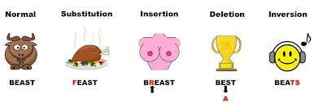
Types of Gene Mutations
Point
Substitution
Insertion
Deletion
Frame shift

Slide 3
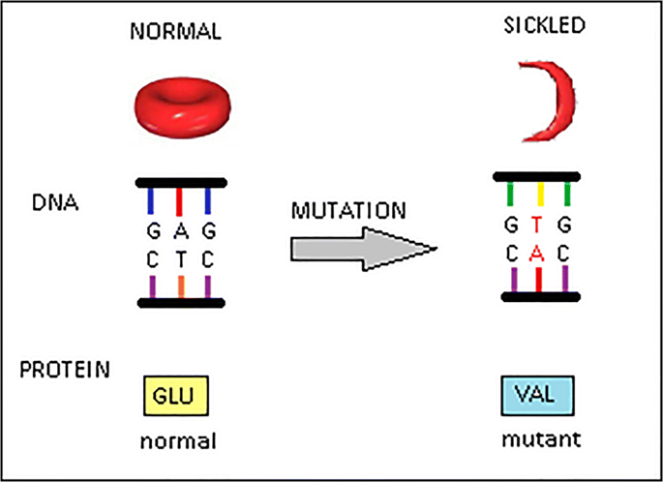
Point mutation
Point mutation that affects a single nucleotide or nucleic acid.

Slide 4
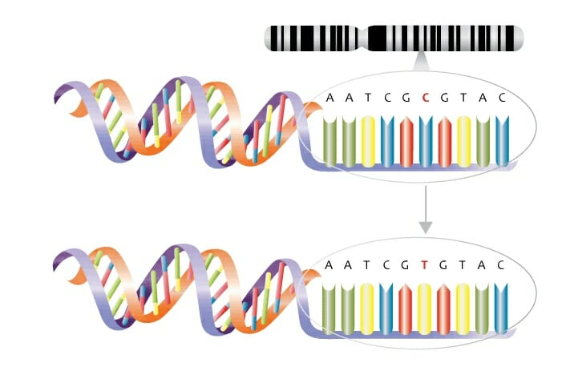
Substitution mutation

Slide 5
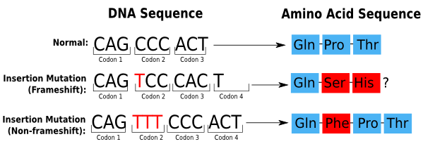
Insertion mutation

Slide 6
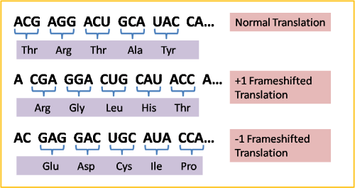
Frame -shift Mutation
Inserting or deleting one or more nucleotides
Changes the “reading frame” like changing a sentence
Proteins built incorrectly

